Slide 1


Paris, March 19th, 2019
Jean-Guillaume Péladan | Sycomore Asset Management
Pierrick Arnault | BNP Paribas Securities Services
Audrey Manh-Tilleul | Sycomore Asset Management

Slide 2




what does the carbon footprint tell us?
A question of greenhouse gas scope
carbon
footprint
TONS eq. CO₂/ YEAR/ M€ invested
Sports cars
Online clothes retail
Water, waste and energy management
Trains, tram, subways, rail systems
7
17
4168
839
Source: Carbon footprint calculated as scope 1, scope 2 and Tiers one supplier scope 3 in CO₂ eq. / year / M€ invested as of June 2018, Trucost; example used in the Green Finance Handbook of the French SIF, see https://www.frenchsif.org/isr-esg/wp-content/uploads/UK_Executive_Summary_13nov2018.pdf

Slide 3





what does the carbon footprint tell us?
A question of environmental scope
CARBON FOOTPRINT
(kg eq. CO₂/ liter)
Existing indicators, such as the carbon footprint or E rating ratings, do not reflect on the risk of transition, nor on climate risk or on issues beyond carbon, such as damages from plastics, air quality, nuclear waste or biodiversity
Source: carbon footprint of packaging according to the Ecoinvent greenhouse gas emissions factor and the ADEME FOODGES database, Quantis calculations, 2018.

Slide 4

the need for integrating environmental issues
Why do environmental challenges matter to investors?
Risks
Opportunities
Which are the activities, companies, portfolios, projects that positively contribute to the environmental transition to create a sustainable world?
Technology risk
Policy risk
Reputation risk
Market risk
Acute risk
Chronic risk
Transition
Resilience
Solutions
Mitigation
Capital reallocation
Regulatory
landscape
Paris agreement
SDGs
Impact investing
TCDF recommendations
European Commission's Action Plan for a greener and cleaner economy
Fiduciary duty
Article 173
Source: Sycomore AM.

Slide 5




NEC: a new advanced metric
net environmental contribution™
-100%
-10%
0%
+10%
+100%
ENVIRONMENTAL DAMAGES
Impact analysis by activity
ENVIRONMENTAL BENEFITS
Average environ-mental impact
Alignment with the climate goals
Contribution to the environmental transition
Non
significant
Transition risk
very high high
limited very limited
A metric designed to assess transition risk, drive investment decisions and report according to the TCFD recommendations and the article 173 of the French law on energy transition for green growth
Source: Sycomore AM.

Slide 6
integrating key environmental issues
 | CLIMATE | WASTE | BIODIVERSITY | WATER | AIR QUALITY | Examples of specific KPIs & certifications
Ecosystems-related: food & beverages, water, forestry/wood/pulp | ✓ |  | ✓ | ✓ |  | Type of agriculture and farming (intensive vs organic, …) GHG content and water footprint Palm Oil usage (RSPO) Forestry and wood certifications (PEFC, FSC, SFI) APUR, Ecolabels, Blue Angel...
Energy: fuel, heat and electricity | ✓ | ✓ | ✓ |  |  | Species depletion (Nb/kWh) Type of extraction of fossil fuels Carbon Tracker Initiative over 2°C budget for fossil fuels gCO₂e/kWh…
Mobility: passenger transportation and freight | ✓ |  |  |  | ✓ | Passenger mobility: CO₂e, NO_{X} and fine particles per passenger.km Freight: CO₂e, NO_{X} and fine particles per ton.km
Construction: building and real estate | ✓ | ✓ |  |  | ✓ | Energy Intensity carbon content of materials and constructive solutions BREEAM, LEED, BBCA, HQE, etc.…
Production: mining, metals, chemicals, textile, personal & home care, IT, appliances, waste | ✓ | ✓ | ✓ | ✓ |  | ReCiPe method with ecosystem quality endpoint from Ecoinvent, type of mine, biodiversity management Product reliability and lifespan MSI score for textile from Sustainable Apparel Coalition % of input with recycled materials …
5 ISSUES
DOMAINS
✓
Key issues for the impact domain
Important issue, but hard to quantify (lack of reliable data)
A multi-dimensional approach for an holistic view of the net environmental impact
Source: NEC β Sycomore AM, Quantis and I Care&Consult, October 2018.

Slide 7






example: food products
Main impacts in the value chain: upstream
3 main environmental impacts: GHG, biodiversity and water
Estimation of environmental impact per grams of nutrient
NEC
Organic veg. unpacked
+100%
Organic pulses
Organic veg. canned (97%)
Organic milk(53%)
Standard veg. canned (64%)
Average footprint
Organic egg (33%)
Organic fish (24%)
Milk (22%)
Environmental performance
Organic chicken (-7%)
Standard egg (0%)
Chicken (-41%)
Beef (-100%)
-100%
Source: Quantis and Sycomore AM calculations, 3 main quantifiable environmental issues: GHG, biodiversity and water and main impacts during the production phase, Food & Beverages framework, NEC 1.0.

Slide 8
























delivering manageable results
More transition risks…
More resilience and sustainable growth…
-100%
0%
+100%
-100%
-40%
-3%, MSCI Europe NR*
+43%
+100%
Source: NEC 1.0 of a selection of listed equities and of MSCI Europe Net Return (reinvested dividends), calculated by Sycomore AM, Quantis and I Care&Consult on 2017 data, October 2018.

Slide 9
tested data set
universe
Companies in the Stoxx Europe 600 (all market capitalization accross 17 countries) which have a NEC score (570 companies)
Testing period of 1 year / 3 years / 5 years
methodology
Extraction of the weekly close prices
Risk/Performance analysis on different strategies and different time frames
NEC scores computed from June 2017 to February 2018, mainly with 2016 data
A company data centered on a 2016 picture
Source: NEC β Sycomore AM, Quantis and I Care&Consult, October 2018.

Slide 10
what is the difference between NEC and E ratings?
Majority of the components of the Stoxx Europe 600 have a strong environmental rating (red) whereas their NEC is often neutral (blue)
Environmental ratings are calculated by aggregating several ratings at corporate/ holding level (carbon footprint, environmental progress, disclosed reports)
The NEC is based on a lifecycle assessment using physical data, and built activity by activity
The NEC: a disruptive metric to overcome the limits of existing environmental ratings
NEC distribution (blue) versus average environmental ratings (red) with their market cap
Source: NEC β Sycomore AM, Quantis and I Care&Consult, October 2018.

Slide 11
6 Tested NEC-based investment strategies
AVERAGE NEC
Green strategy | Clear positive contribution
NEC b/t +10% and +100% (101 companies)
Green overweight strategy | Highly positive contribution
NEC b/t +30% and +100% over weighted by a factor of 10
Neutral Green strategy | Neutral and positive contribution
NEC b/t -10% and +100%
Sector neutral green strategy | Sector neutral best in class NEC
Top 10% by sector
Red strategy | Clear negative contribution
NEC b/t -100% and -10% (76 companies)
Red overweight strategy | Highly negative contribution
NEC b/t -100% and -30% over weighted by a factor of 10
+25%
+14%
+3%
+3%
-30%
-32%
Source: NEC β Sycomore AM, Quantis and I Care&Consult, October 2018.

Slide 12
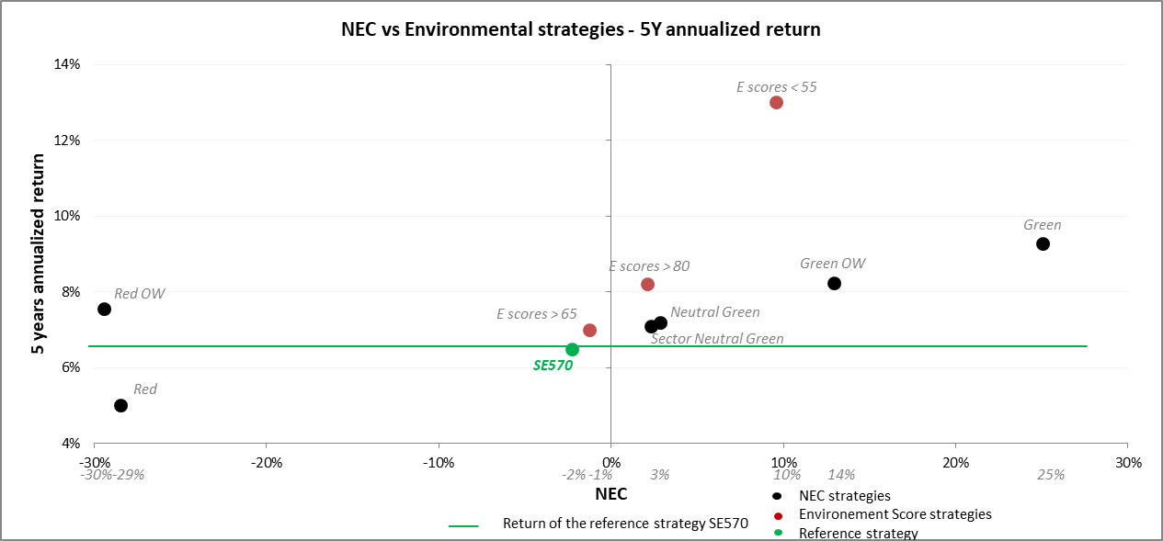
what is the difference between NEC and E ratings?
Source: NEC β Sycomore AM, Quantis and I Care&Consult, October 2018.

Slide 13
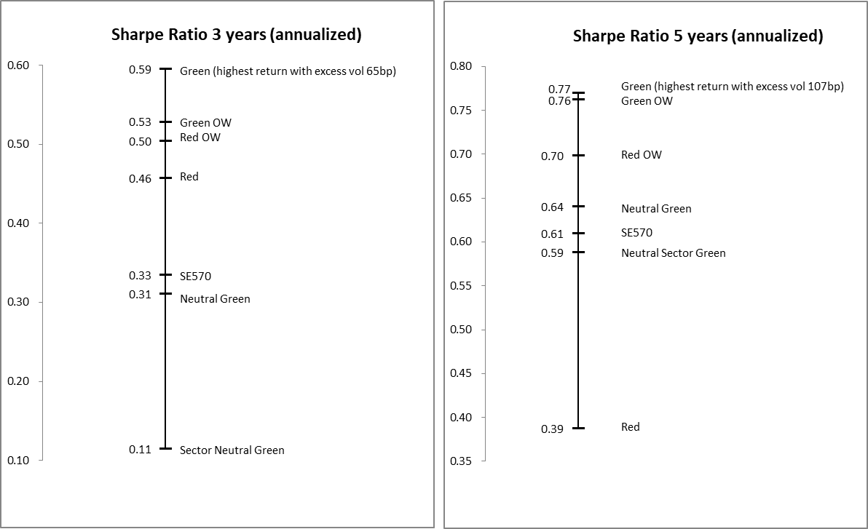
risk-adjusted returns on 3-year and 5-year periods
Results on a yearly period (2015, 2016, 2017) show no stable pattern
Results on 3 years and 5 years are more conclusive:
On a 3-year or 5-year period, the Green Strategy shows the best Sharpe ratio

Slide 14
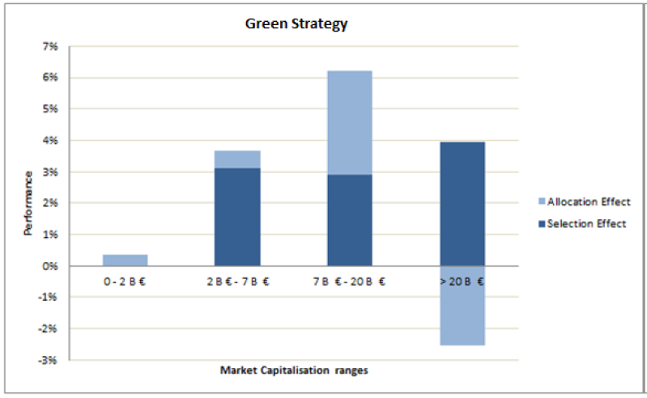
where does the Green Strategy outperformance come from?
Performance attributions per market cap and per sector show that more than 80% of the outperformance is explained by the security selection based on the NEC.

Slide 15

key take away
Similar patterns between the NEC and stock performance emerge over 3 and 5-year periods
The NEC selection effect is not significantly biased neither by market capitalization nor by sector allocation
The NEC metric is completely different from existing environmental ratings
The transition risk measured by the NEC metric appears to be material on long term stock returns
The NEC is worth being further improved and rolled out
Launch of the NEC Initiative to share and scale the NEC methodology on an open source platform operated by Quantis
Source: NEC β Sycomore AM, Quantis and I Care&Consult, October 2018.

