Slide 1
Unconventional Monetary Policy and Credit Rating Dynamics: Evidence from a Natural Experiment
Nordine Abidi
European Central Bank
Matteo Falagiarda
European Central Bank
Ixart Miquel-Flores
European Central Bank
18-19 March 2019
12th Financial Risks INTERNATIONAL FORUM
The views expressed are those of the authors and do not necessarily reflect those of the European Central Bank or the Eurosystem.

Slide 2
Motivation
"The ratings [. . . ] are and must be construed solely as, statements of opinion and not statements of fact or recommendations to purchase, sell, or hold any securities." (Credit Rating Agency Disclaimer)
Nevertheless, still significant reliance on CRAs by market participants:
Direct: restrictions on investing in non investment-grade bonds
Indirect: benchmark with underlying rating

Slide 3
Motivation
"The ratings [. . . ] are and must be construed solely as, statements of opinion and not statements of fact or recommendations to purchase, sell, or hold any securities." (Credit Rating Agency Disclaimer)
Nevertheless, still significant reliance on CRAs by market participants:
Direct: restrictions on investing in non investment-grade bonds
Indirect: benchmark with underlying rating
Less known:
Explicit reliance on CRAs by major central banks for monetary policy (ECB, Fed, etc.)

Slide 4
Motivation
"The ratings [. . . ] are and must be construed solely as, statements of opinion and not statements of fact or recommendations to purchase, sell, or hold any securities." (Credit Rating Agency Disclaimer)
Nevertheless, still significant reliance on CRAs by market participants:
Direct: restrictions on investing in non investment-grade bonds
Indirect: benchmark with underlying rating
Less known:
Explicit reliance on CRAs by major central banks for monetary policy (ECB, Fed, etc.)
This paper:
  Investigates the behaviour of CRAs and firms using a natural experiment in monetary policy
  Contributes to better assessing the consequences of the explicit reliance on CRAs by central banks

Slide 5
This paper
Well known trade-off faced by CRAs (pleasing the issuer vs. reputational costs, Bolton et al., 2012)
Corporate Sector Purchase Programme (CSPP) of the ECB:
  Ideal laboratory experiment for identification:
    Unexpected by market participants
    Rating-based rule for CSPP eligibility
    Direct link between ECB purchases and corporate entities

Slide 6
This paper
Well known trade-off faced by CRAs (pleasing the issuer vs. reputational costs, Bolton et al., 2012)
Corporate Sector Purchase Programme (CSPP) of the ECB:
  Ideal laboratory experiment for identification:
    Unexpected by market participants
    Direct link between ECB purchases and corporate entities
    Rating-based rule for CSPP eligibility
"The announcement by the ECB on March 10 to extend its APP to include investment grade non-bank corporate bonds caught the market by complete surprise.” (ICMA, 2016)

Slide 7
This paper
Well known trade-off faced by CRAs (pleasing the issuer vs. reputational costs, Bolton et al., 2012)
Corporate Sector Purchase Programme (CSPP) of the ECB:
  Ideal laboratory experiment for identification:
    Unexpected by market participants
    Direct link between ECB purchases and corporate entities
    Rating-based rule for CSPP eligibility

Slide 8
This paper
Well known trade-off faced by CRAs (pleasing the issuer vs. reputational costs, Bolton et al., 2012)
Corporate Sector Purchase Programme (CSPP) of the ECB:
  Ideal laboratory experiment for identification:
    Unexpected by market participants
    Direct link between ECB purchases and corporate entities
    Rating-based rule for CSPP eligibility
The eligibility to be purchased under the CSPP relies explicitly (but not entirely) on a rating-based rule (“a minimum first-best credit assessment of at least credit quality step 3”)
We call it first-best rating rule ↔ at least a BBB- from at least one CRA

Slide 9
Example
Non-eligible
(Potentially) eligible
[BB+; BB+; BB+; #NA]
[BBB-; BB+; BB+; #NA]
First-best rating BB+
First-best rating BBB-

Slide 10
This paper
Well known critical friction related to CRAs: reliance on fees from issuers as a main source of revenue (Bolton et al., 2012)
Institutionalized CRAs oligopoly
First-best rating rule: at least BBB- for at least one of the CRAs

Slide 11
This paper
Well known critical friction related to CRAs: reliance on fees from issuers as a main source of revenue (Bolton et al., 2012)
Institutionalized CRAs oligopoly
First-best rating rule: at least BBB- for at least one of the CRAs
Distortions in the typical
trade-off faced by CRAs?
QE eligibility premium vs.
reputational costs

Slide 12
Example
Non-eligible
(Potentially) eligible
[BB+; BB+; BB+; #NA]
[BBB-; BB+; BB+; #NA]
First-best rating BB+
First-best rating BBB-

Slide 13
Example
Non-eligible
(Potentially) eligible
[BB+; BB+; BB+; #NA]
[BBB-; BB+; BB+; #NA]
QE eligibility premium
> reputational costs
First-best rating BB+
First-best rating BBB-

Slide 14
Main findings
Significant impact on the behavior of market participants
Rating upgrades concentrated on bonds located below, but close to, the eligibility frontier…
  … precisely on the territory where the incentives of market participants are expected to be more sensitive to the policy design
Small impact from a macro perspective and no risks from ECB risk management perspective

Slide 15
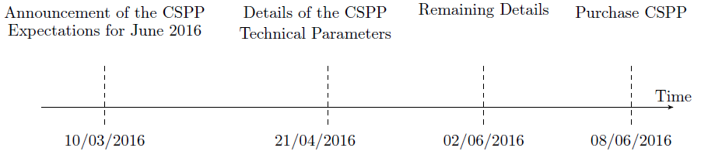
CSPP timeline

Slide 16
CSPP institutional framework
CSPP eligibility criteria:
Issued by a firm established in the euro area
Issued by a non-bank corporation
Denominated in euro
Minimum remaining maturity of six months and a maximum remaining maturity of less than 31 years
Other criteria
Rated with a minimum first-best credit assessment of at least credit quality step 3 (rating of BBB- or equivalent)
Risk monitoring and due diligence activities by ECB staff

Slide 17
CSPP institutional framework
Data collected
CSPP eligibility criteria:
Issued by a firm established in the euro area
Issued by a non-bank corporation
Denominated in euro
Minimum remaining maturity of six months and a maximum remaining maturity of less than 31 years
Other criteria
Rated with a minimum first-best credit assessment of at least credit quality step 3 (rating of BBB- or equivalent)
Risk monitoring and due diligence activities by ECB staff
✓
✓
✓
✓
✓
x

Slide 18
CSPP institutional framework
Data collected
CSPP eligibility criteria:
Issued by a firm established in the euro area
Issued by a non-bank corporation
Denominated in euro
Minimum remaining maturity of six months and a maximum remaining maturity of less than 31 years
Other criteria
Rated with a minimum first-best credit assessment of at least credit quality step 3 (rating of BBB- or equivalent)
Risk monitoring and due diligence activities by ECB staff
✓
✓
✓
✓
✓
x
Around 1750 bonds in March 2016 from 16 euro area countries

Slide 19
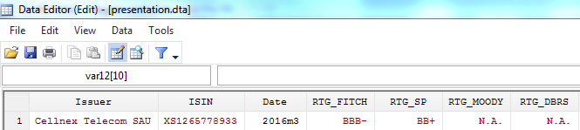
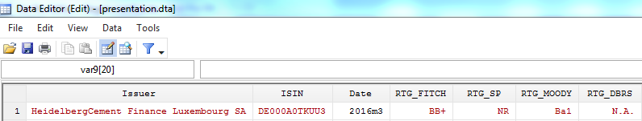
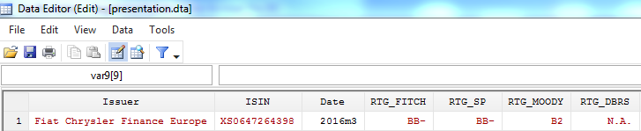
Intuition of the first-best rating rule
CSPP-eligible
Below,
but close to,
eligibility
Below, but
farther away
from eligibility

Slide 20
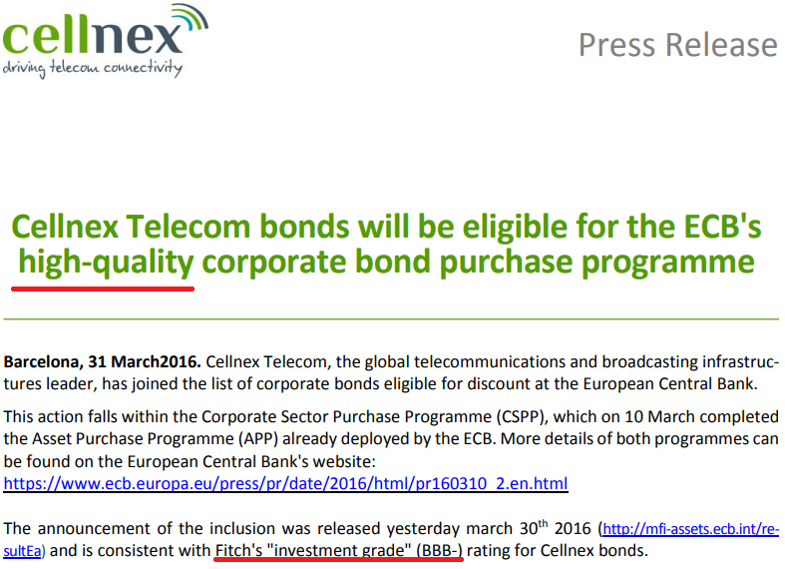
The first-best rating rule at work
Sources: Company website

Slide 21
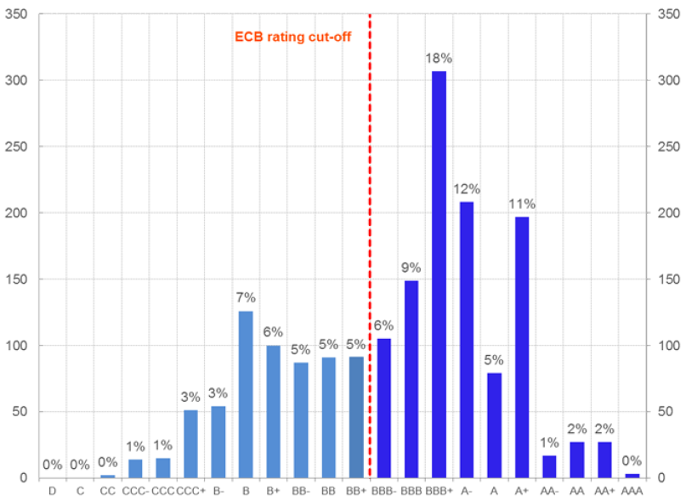
The first-best rating distribution in March 2016
Bonds by first-best rating
(March 2016 – number and percentages)
Sources: Bloomberg, authors' computation.

Slide 22
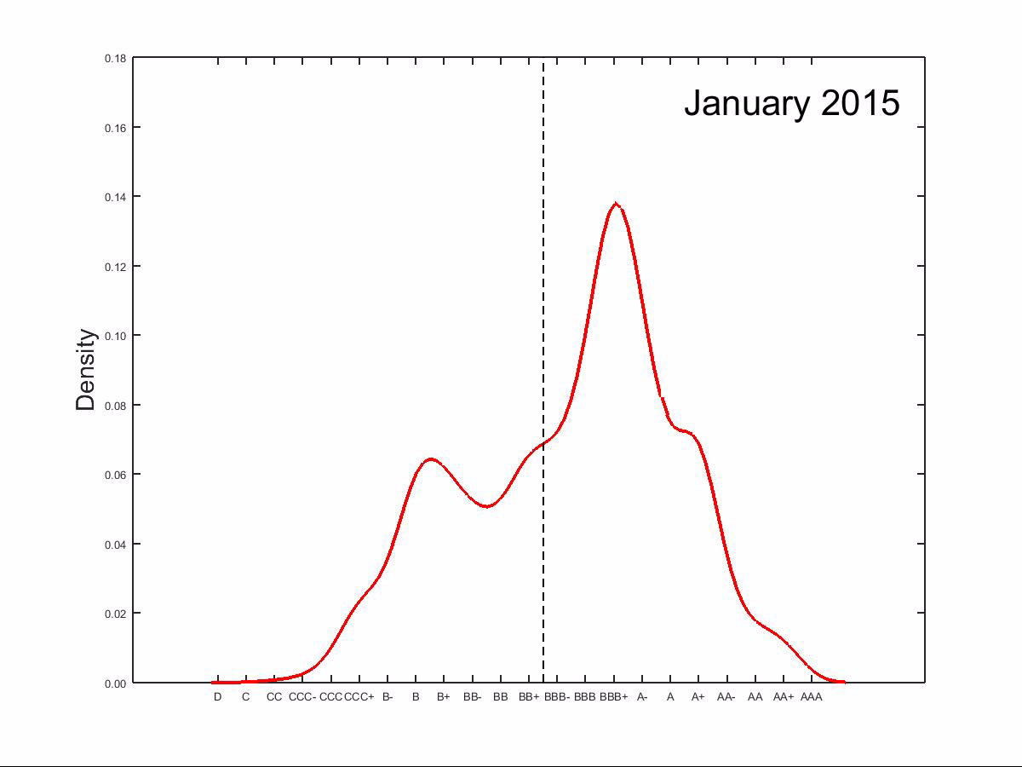
Evolution of the first-best rating distribution
CSPP Short Movie
(January 2015 - December 2017 – Kernel density)

Slide 23
Our prediction
The probability of becoming eligible has increased after the launch of the programme
Securities located below, but close to, the eligibility frontier are likely to have experienced positive rating adjustments
    Hypothesis: Bonds around the eligibility frontier are affected similarly by macroeconomic shocks
      Disentangling macro effects from CRAs behaviour

Slide 24
Roadmap of the empirical strategy
The aggregate effects of the corporate QE
Cross-sectional variation in the CRAs response
  Below the eligibility frontier
  Around the eligibility frontier
Robustness checks

Slide 25
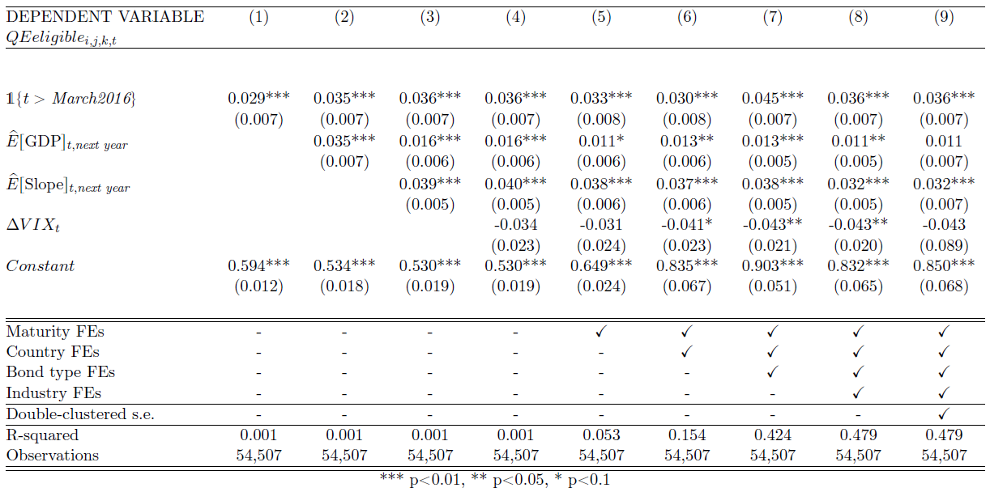
The aggregate effects of the corporate QE

Slide 26
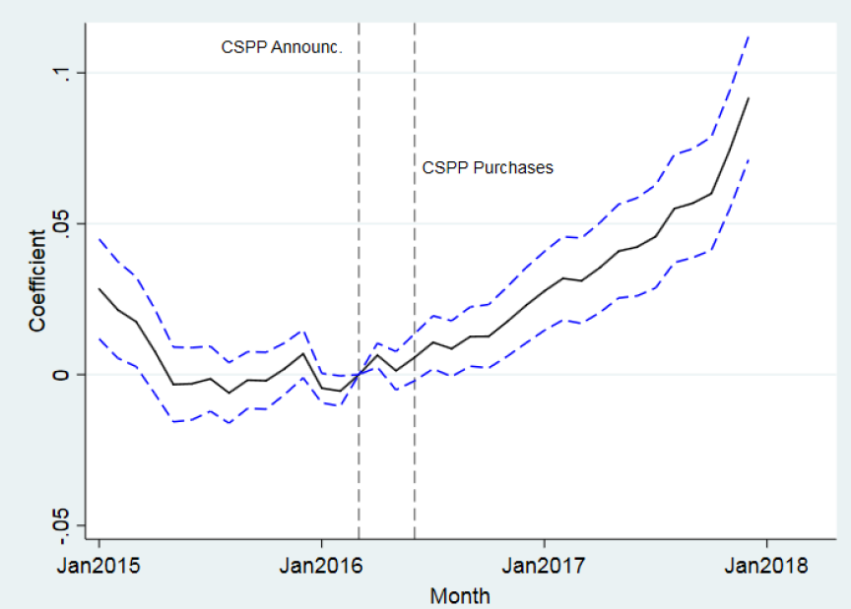
Placebo test
Monthly dummy coefficients
(Monthly dummy coefficients from Eq.3 – Dashed lines denote 95% interval)
Sources: Bloomberg, authors' computation.

Slide 27
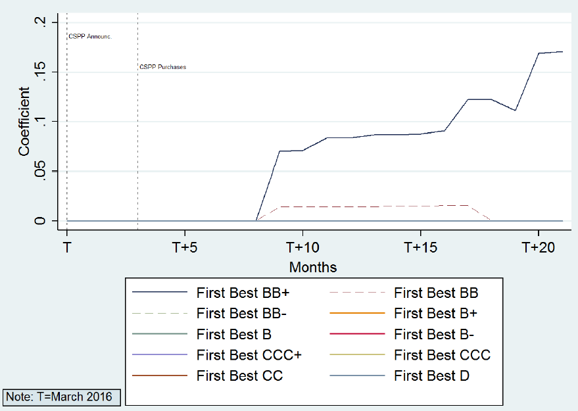
Below the CSPP eligibility frontier
The non-linear effects of the CSPP
(results of Eq.4 (Section IV.B) bonds with at least a publicly available rating in March 2016 – Eligibility coefficient)
Sources: Bloomberg, authors' computation.

Slide 28
Around the CSPP eligibility frontier
Key assumption:
Bonds closely around the eligibility frontier are affected similarly by business cycle fluctuations…
… as, up to a rating, they have a very similar credit risk profile (after controlling for macro developments and (un)observed characteristics)
Therefore, their rating dynamics should not be different

Slide 29
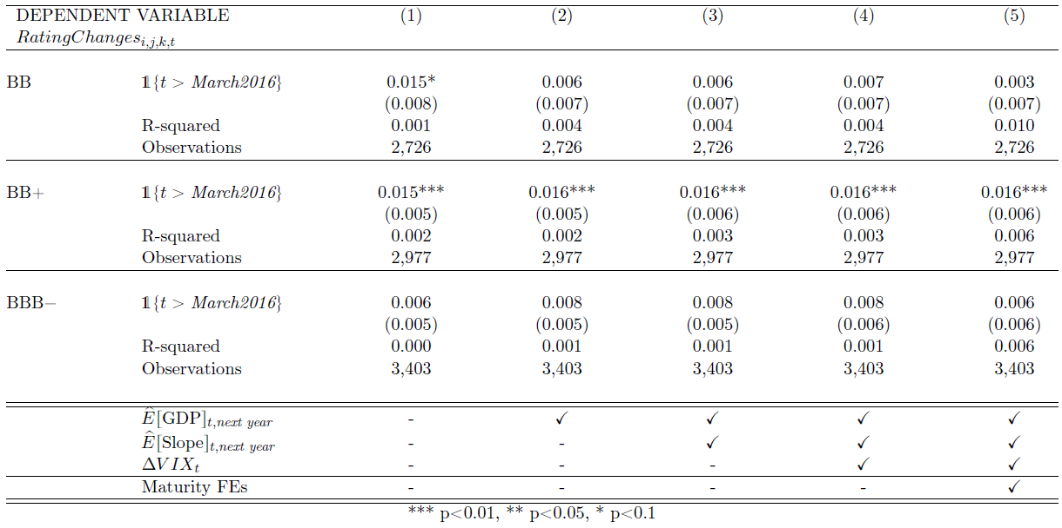
Around the CSPP eligibility frontier

Slide 30
More on the key assumption
Controlling for other fundamentals
  Other EA controls (CESI, unemployment rate, IP, stock market index, PMIs)
  Country-level controls (unemployment rate, IP, stock market indexes, expected default frequencies)
  Industry-level controls (stock market indexes)
  Issuer-level controls (leverage)
  Bond-level controls (bid-ask spread, returns, size)
Firm-level characteristics around the eligibility frontier

Slide 31
Firm-level characteristics around the frontier
Total assets
(EUR million)
Leverage ratio
(in percent)
Sources: Orbis Europe, Bloomberg and other sources.

Slide 32
Additional findings and robustness checks
Sharpening the identification:
Bonds rated by non-recognised CRAs (control group)
  No rating upgrades for bonds rated by the non-recognised CRAs

Slide 33
Additional findings and robustness checks
Sharpening the identification:
Bonds rated by non-recognised CRAs (control group)
  No rating upgrades for bonds rated by the non-recognised CRAs
Euro-denominated vs. non-euro-denominated bonds (control group)
  No rating upgrades for non-euro-denominated bonds

Slide 34
Additional findings and robustness checks
Additional exercises:
Step-by-step rating migration
  Rating upgrades driven by bonds observing only one rating change
Rating shopping
  Rating upgrades stronger for rating-shoppers (ask/withdraw rating)
Controlling for CRAs competition
  Credit rating upgrades driven by bonds rated by two CRAs
  No specific CRA upgraded credit ratings in a systematic way
A two-period difference-in-differences analysis

Slide 35
Additional findings and robustness checks
Additional exercises:
Cross-country differences
Controlling for CRAs disagreement
Probit model
Unfrozen list of bonds (including new issuance)
Weighting by bond size
Bonds with no rating in March 2016

Slide 36
Concluding remarks
Sum up:
The CSPP appears to have had a significant impact on the behavior of CRAs, but small from a macro perspective
  No risks from ECB risk management perspective
The impact is mostly noticeable for bonds located below, but close to, the CSPP eligibility frontier

Slide 37
Concluding remarks
Sum up:
The CSPP appears to have had a significant impact on the behavior of CRAs, but small from a macro perspective
  No risks from ECB risk management perspective
The impact is mostly noticeable for bonds located below, but close to, the CSPP eligibility frontier
Policy recommendations:
Acknowledging the consequences of the explicit reliance on CRAs when designing monetary policy
No normative conclusions on the use of external rating agencies and on the ESCF…
  …whose key role is well documented (Bindseil et al., 2017)

Slide 38
Background slides

Slide 39
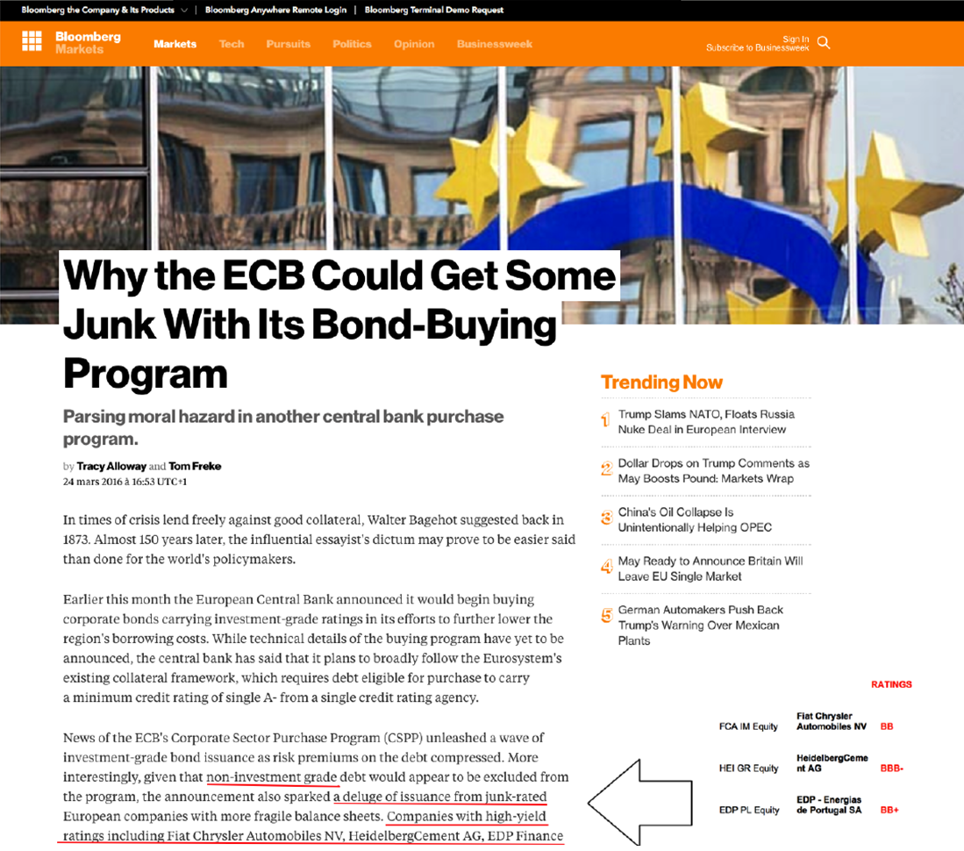
Motivation

Slide 40
Example
ECB cut-off
Market cut-off
Non-eligible
(Potentially) eligible
Yields↓
Yields↓↓
Yields↓
[BB+; BB+; BB+; #NA]
[BBB-; BB+; BB+; #NA]
[BBB-; BBB-; BBB-; #NA]

Slide 41
Additional Remarks
Eligibility and purchases: Eurosystem conducts appropriate credit risk and due diligence procedures on the purchasable universe on an ongoing basis, that limits the risks on the portfolio of the ECB.
Central bank operations and CRA’s reliance.

Slide 42
Action points - Meeting DG-RM and DG-M
Mention the Performance Monitoring Framework and the Risk Management due diligence exercises carried out by the ECB
Avoid potentially misleading expressions (“outsourcing regulatory judgement”, “credit rating inflation”)
No normative conclusions (never drawn! We are not criticizing the current ECF system)
More emphasis on the “frozen list”: some previously unrated bonds have received a new rating that allowed them to become CSPP-eligible (i.e. more issuers)
Incorporate issuer’s leverage as an additional control
Weight our estimates by the size of the bond
Emphasise that our results are significant from a statistical viewpoint but small from an economic perspective (only local impact)
✓
✓
✓
✓
✓
✓
✓

Slide 43
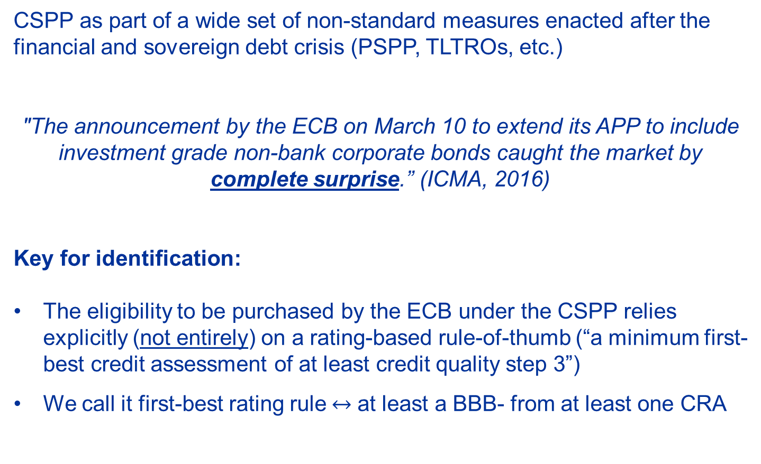
The CSPP: an experiment for identification
CSPP as part of a wide set of non-standard measures enacted after the financial and sovereign debt crisis (PSPP, TLTROs, etc.)
"The announcement by the ECB on March 10 to extend its APP to include investment grade non-bank corporate bonds caught the market by complete surprise.” (ICMA, 2016)
Key for identification:
The eligibility to be purchased by the ECB under the CSPP relies explicitly (not entirely) on a rating-based rule-of-thumb (“a minimum first-best credit assessment of at least credit quality step 3”)
We call it first-best rating rule$↔$ at least a BBB- from at least one CRA

Slide 44
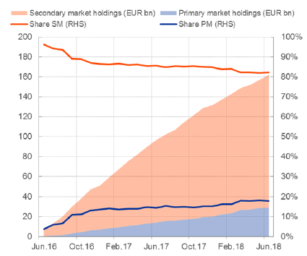
Size of the CSPP
Overview of the CSPP
(Eurosystem corporate bond purchases under the CSPP - EUR bn. and Percentages.)
Sources: ECB, Authors' computation.

Slide 45
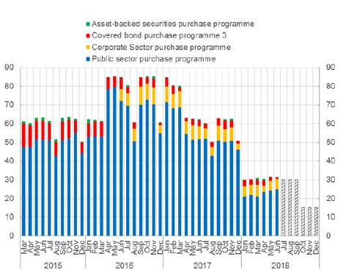
Size of the CSPP
ECB QE programmes
(Eurosystem purchases under the APP - EUR bn)
Sources: ECB, Authors' computation.

Slide 46
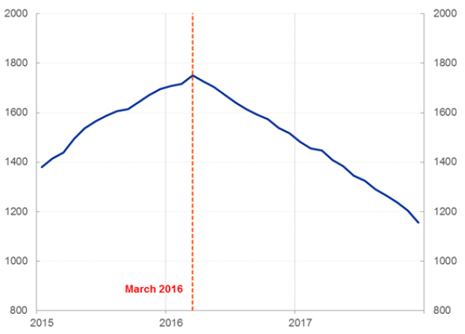
Number of bonds in the frozen list in March 2016
Dynamics of the number of corporate bonds with at least a rating
(Bonds with at least a rating – March 2016.)
Sources: ECB, Authors' computation.

Slide 47
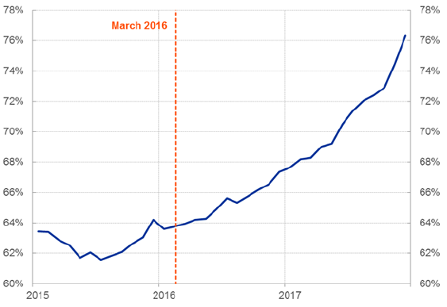
Share of bonds rated at least BBB-
Share of corporate bonds rated at least BBB- by the four recognized CRAs.
(March 2016.)
Sources: ECB, Authors' computation.

Slide 48
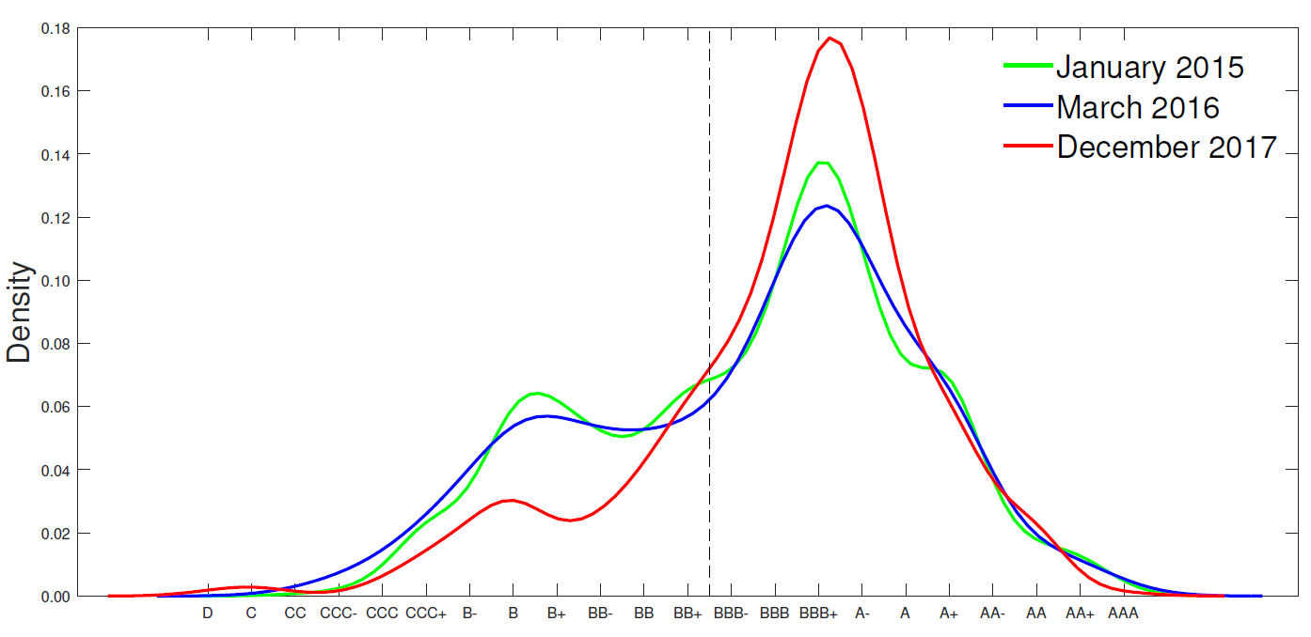
Dynamics of first-best rating distributions
Credit rating inflation and the CSPP
(First-best rating distributions - Kernel density)
Sources: Bloomberg, authors' computation.

Slide 49
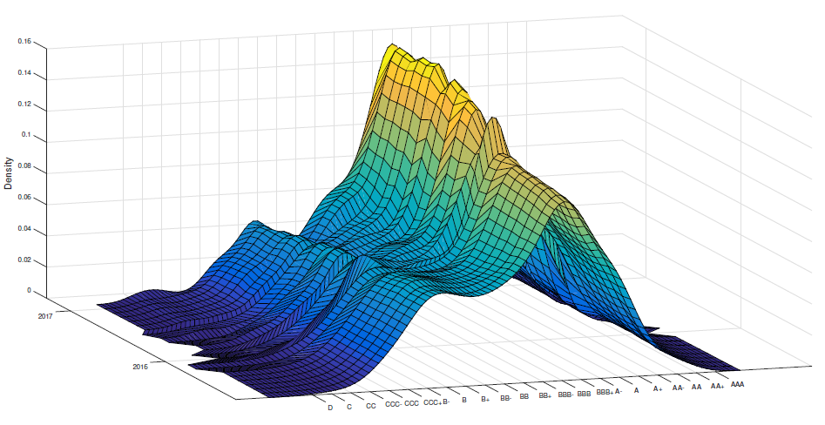
Credit rating inflation: 1-year window around March 2016
Set of first-best rating distribution, frozen list
(Between March 2015 and March 2017.)
Sources: ECB, Authors' computation.

Slide 50
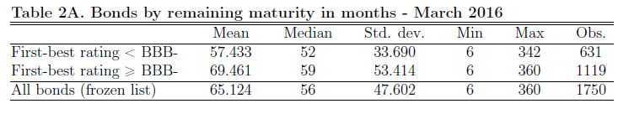
Summary statistics 1

Slide 51
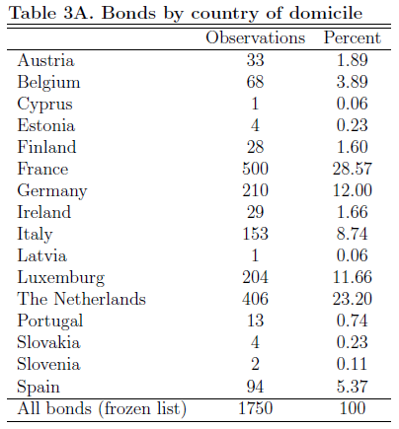
Summary statistics 2

Slide 52
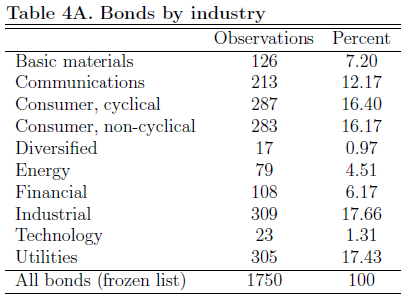
Summary statistics 3

Slide 53
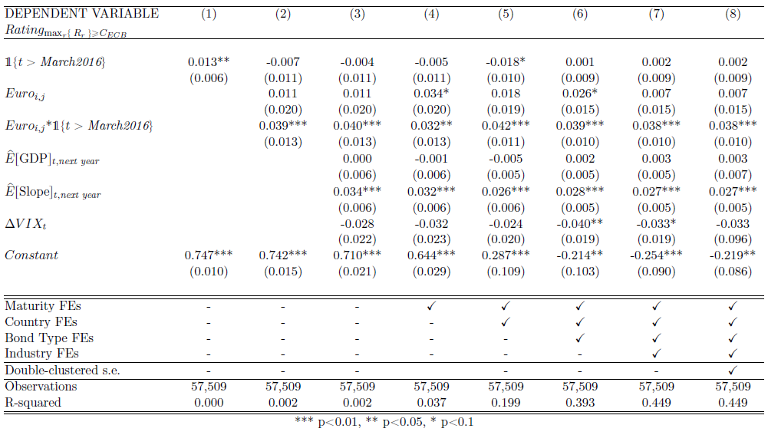
Euro vs. non-euro denominated bonds

Slide 54
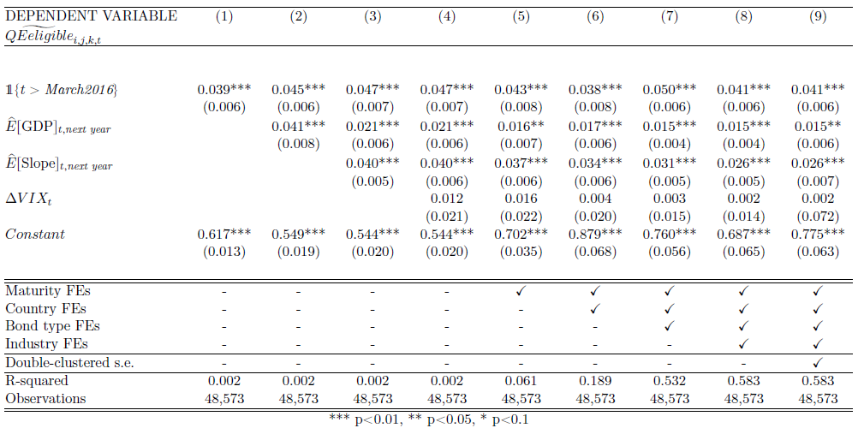
Excluding investment grade bonds not in the ECF and vice-versa

Slide 55
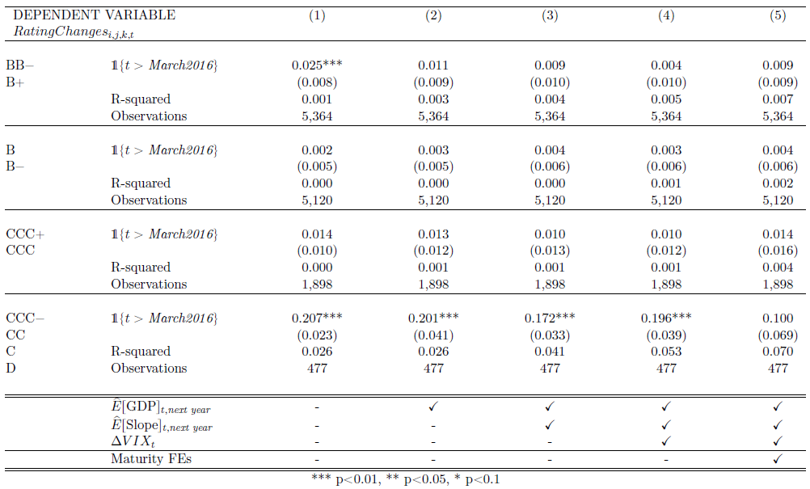
The non-linear effects of the CSPP far below the eligibility frontier

Slide 56
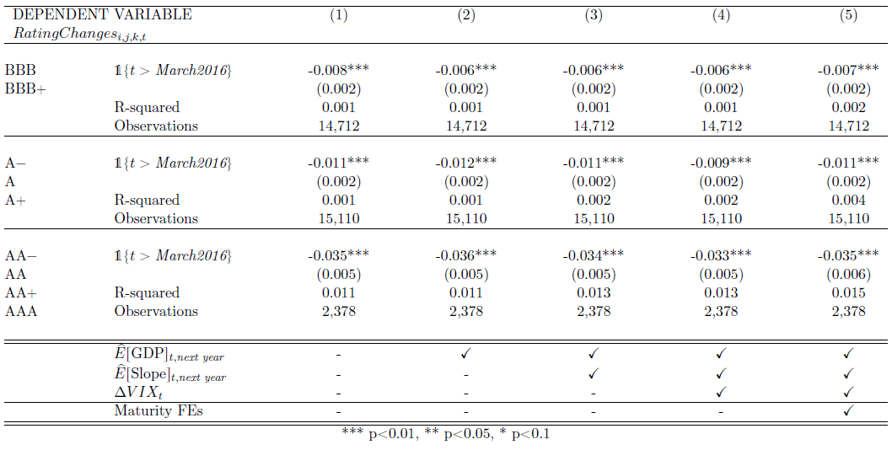
The non-linear effects of the CSPP far above the eligibility frontier

Slide 57
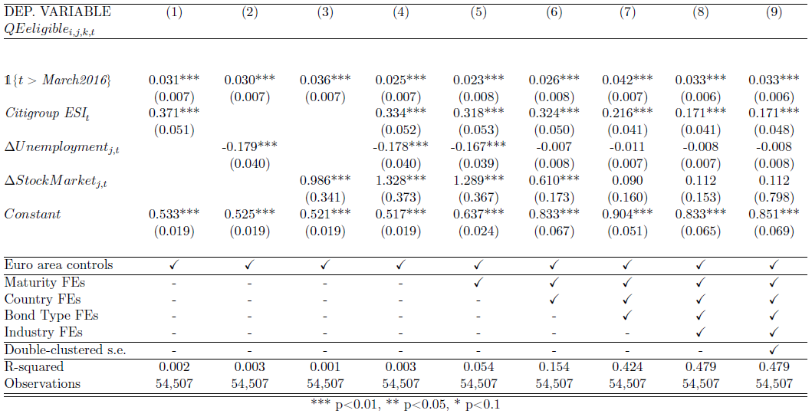
Controlling for additional macro factors

Slide 58
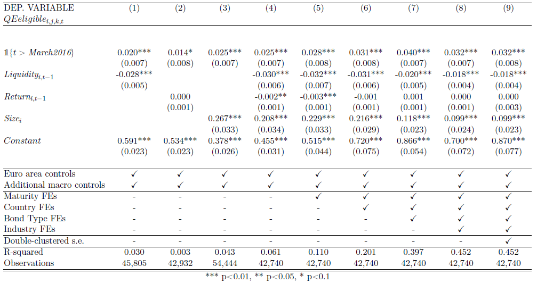
Controlling for additional bond-level characteristics

Slide 59
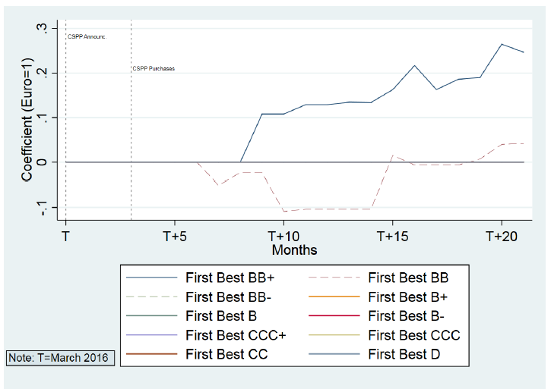
Euro vs. non-euro denominated bonds

Slide 60
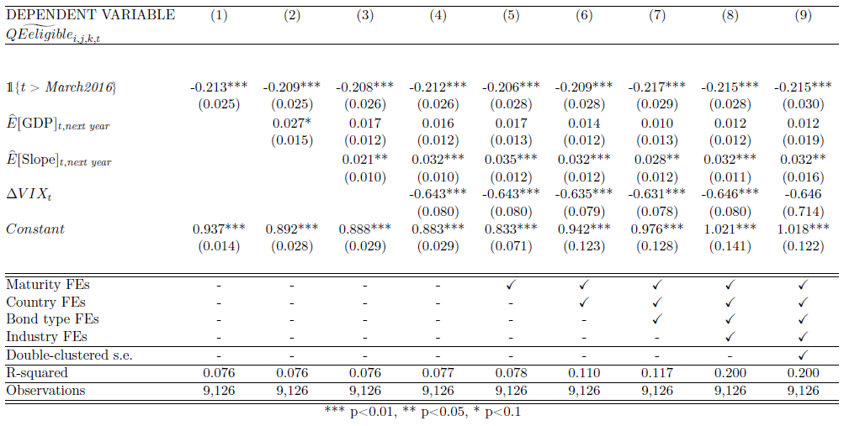
Non-eligible CRAs

Slide 61
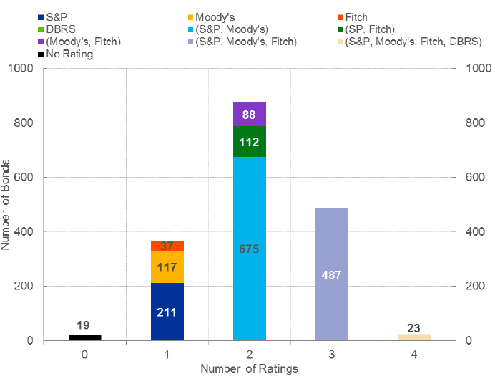
Number of ratings per bond
CRA’s Competition
(Number of ratings of the four recognized CRAs at a bond level – March 2016.)
Sources: ECB, Authors' computation.

Slide 62
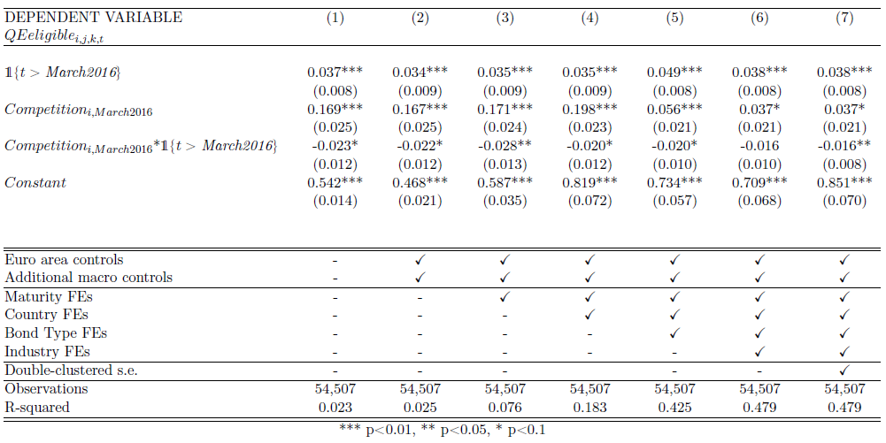
CRAs competition

Slide 63
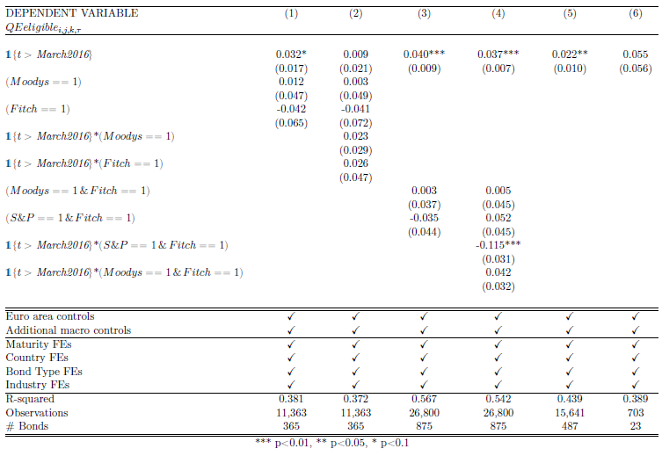
CRAs pivotal role (identifying pivotal CRAs)

Slide 64
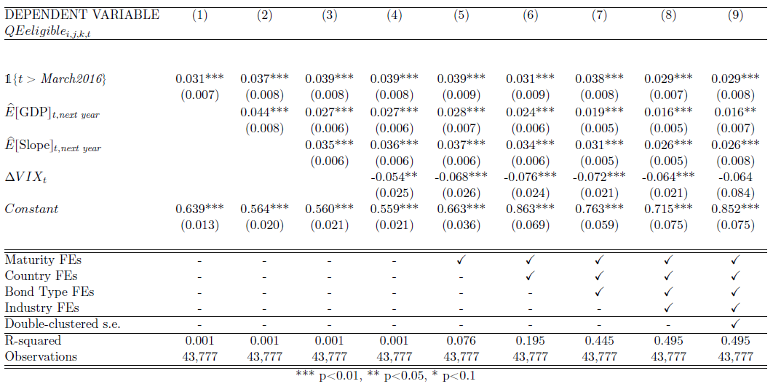
CRAs pivotal role (no change in the number of CRAs)

Slide 65

CRAs pivotal role (at least one change in the number of CRAs)

Slide 66
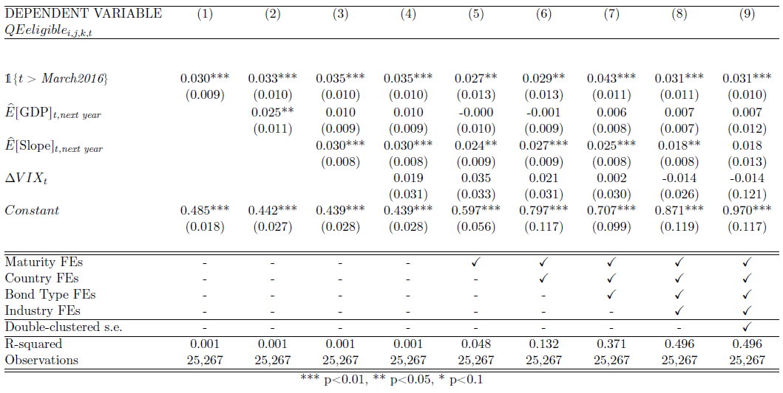
CRAs pivotal role (at least one rating bucket change)

Slide 67

CRAs pivotal role (only one single rating bucket change)

Slide 68

CRAs pivotal role (more than one single rating bucket change)

Slide 69
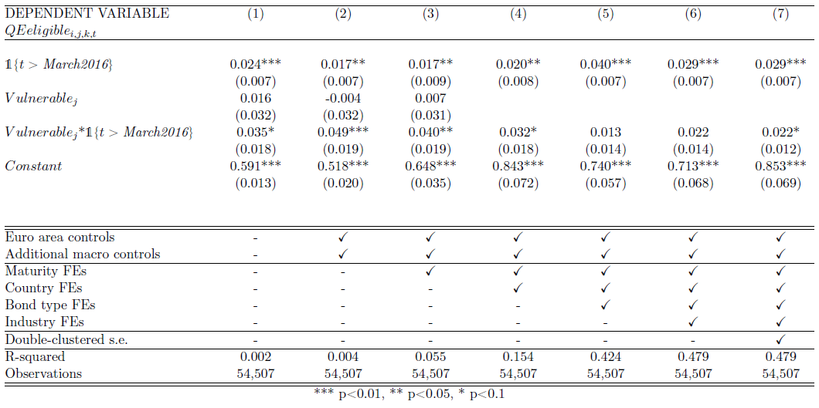
Vulnerable versus less vulnerable countries

Slide 70
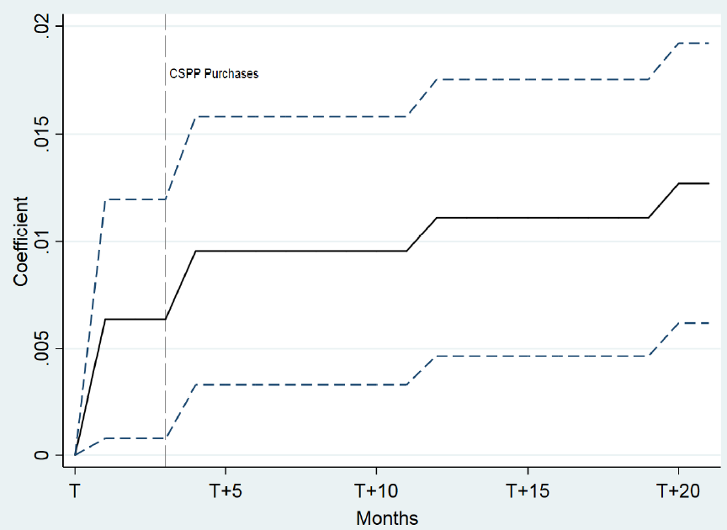
Bonds with no credit rating in March 2016
Bonds with no credit rating
(Coefficient of eligibility.)
Sources: ECB, Authors' computation.

Slide 71
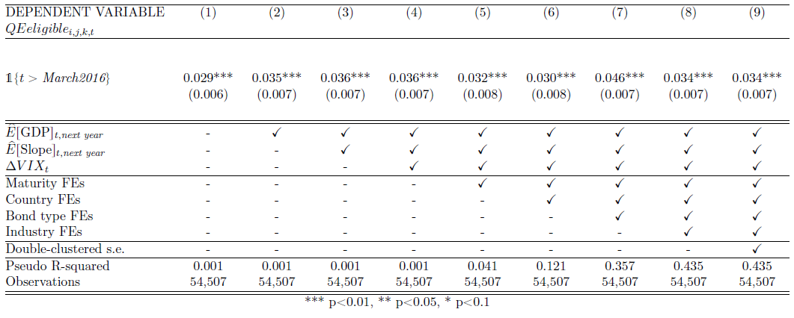
Probit estimation (marginal effects)

Slide 72
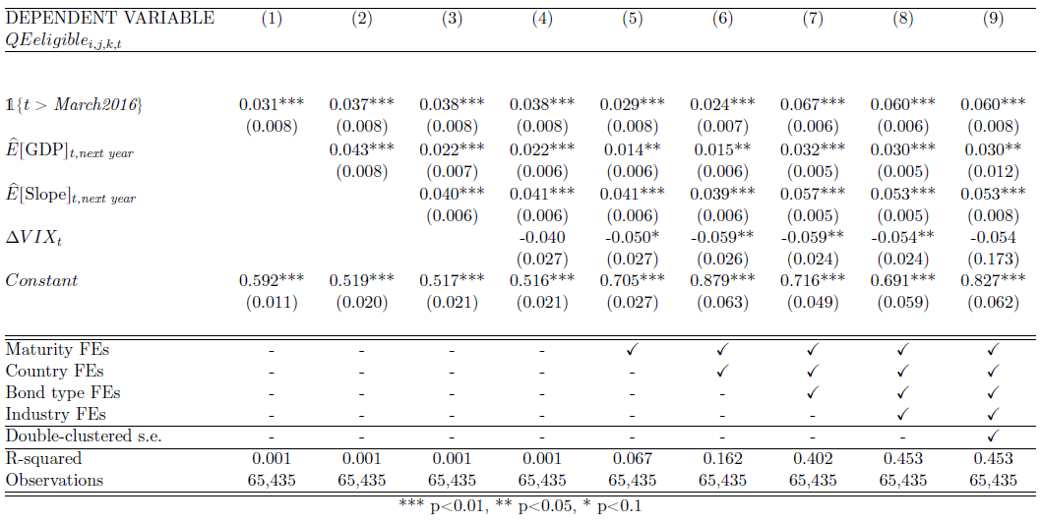
Unfrozen list

Slide 73
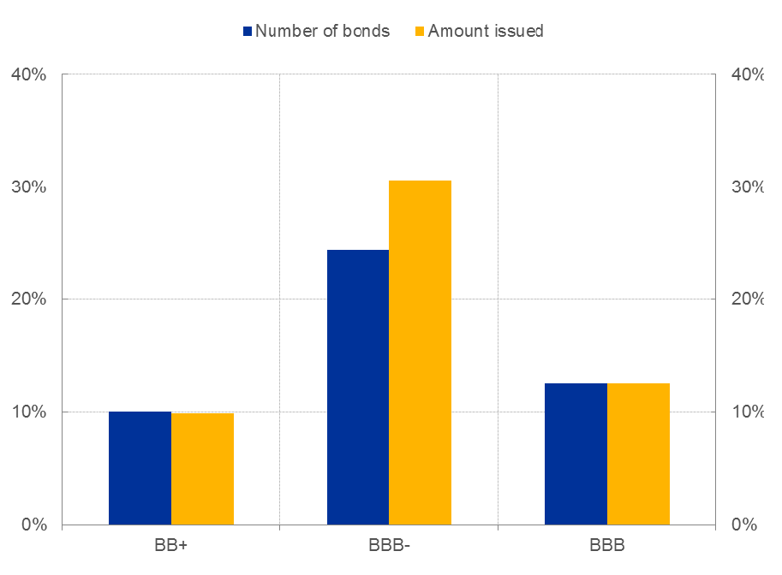
Unfrozen list – New issuance
Share of the bonds issued after March 2016 ending up getting one upgrade with respect to the rating of bonds of the same issuer in March 2016

Slide 74
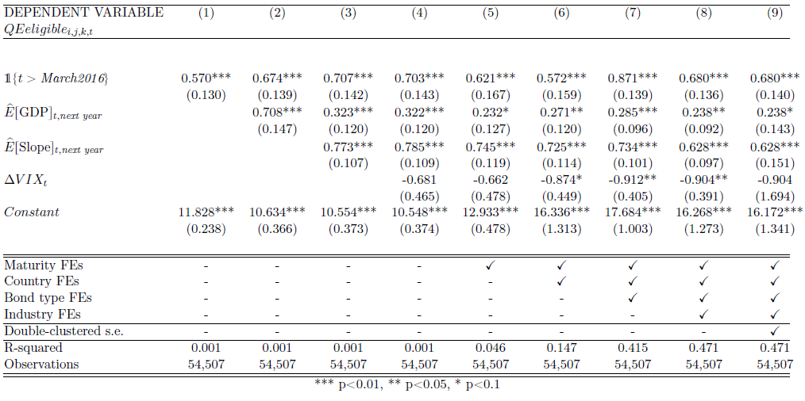
Weighting by bond size

Slide 75
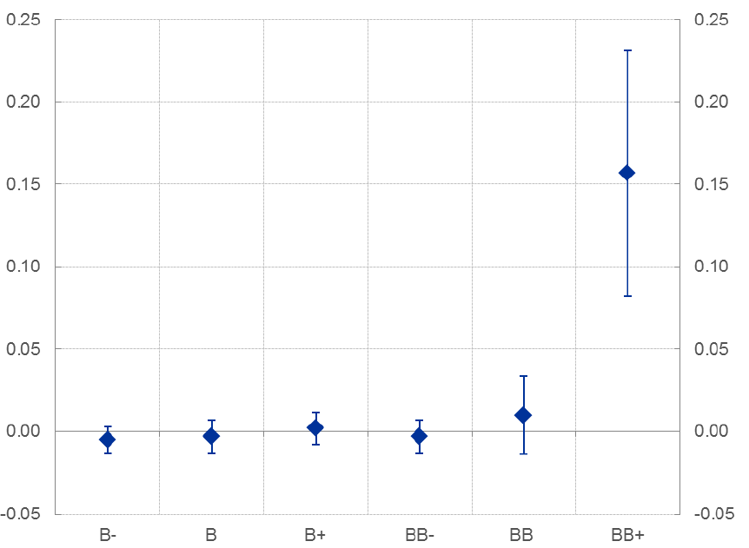
2-period diff-in-diff approach - Eligibility
Coefficient of the interaction term (post-CSPP dummy and ω) by rating bucket (5% cofidence interval) - Eligibility

Slide 76
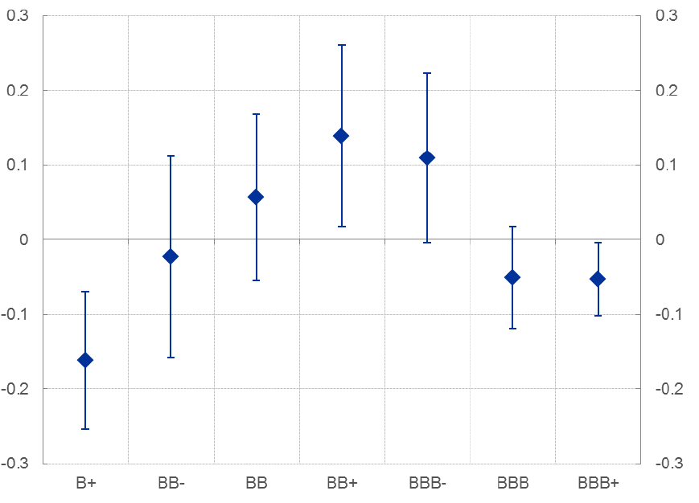
2-period diff-in-diff approach – Only one upgrade
Coefficient of the interaction term (post-CSPP dummy and ω) by rating bucket (5% cofidence interval) – Only one upgrade

Slide 77
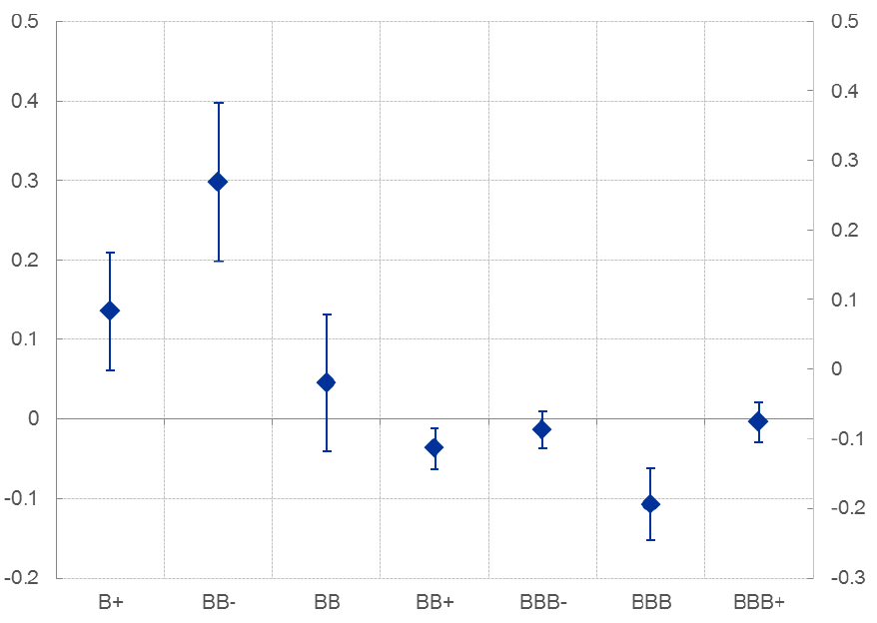
2-period diff-in-diff approach – More than one upgrade
Coefficient of the interaction term (post-CSPP dummy and ω) by rating bucket (5% cofidence interval) – More than one upgrade

Slide 78
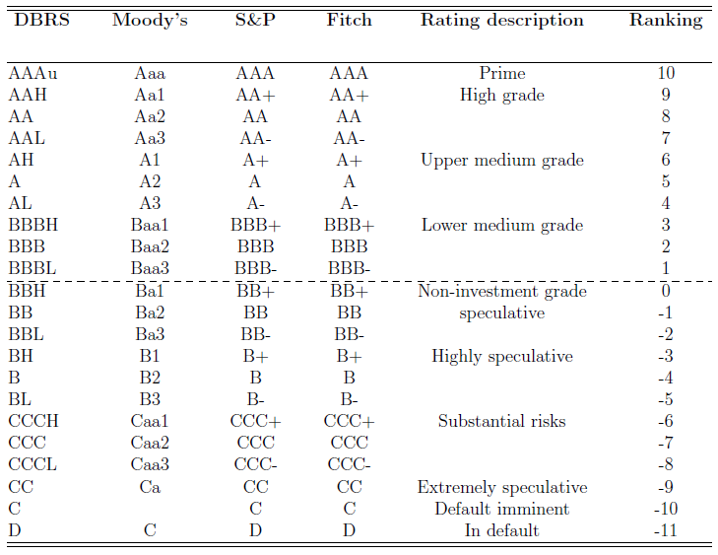
Harmonised rating scale

Slide 79
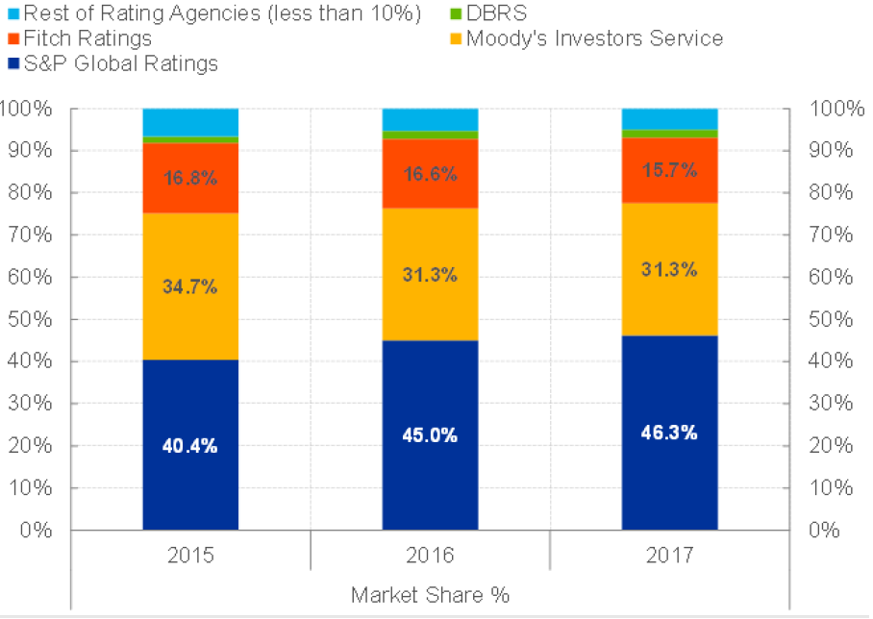
CRAs market share in the EU
CRA Market Share
(Percentages.)
Sources: ESMA, Authors' computation.

Slide 80
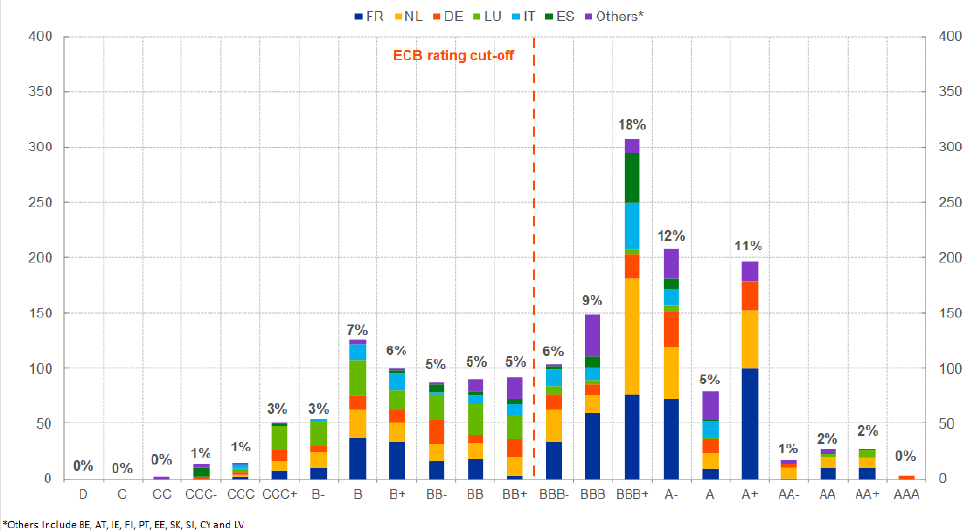
First best ratings by country
Distribution of corporate bonds with at least a rating
(Distribution per Jurisdiction - Percentages, Number – May 2016.)
Sources: Bloomberg , Authors' computation.

Slide 81
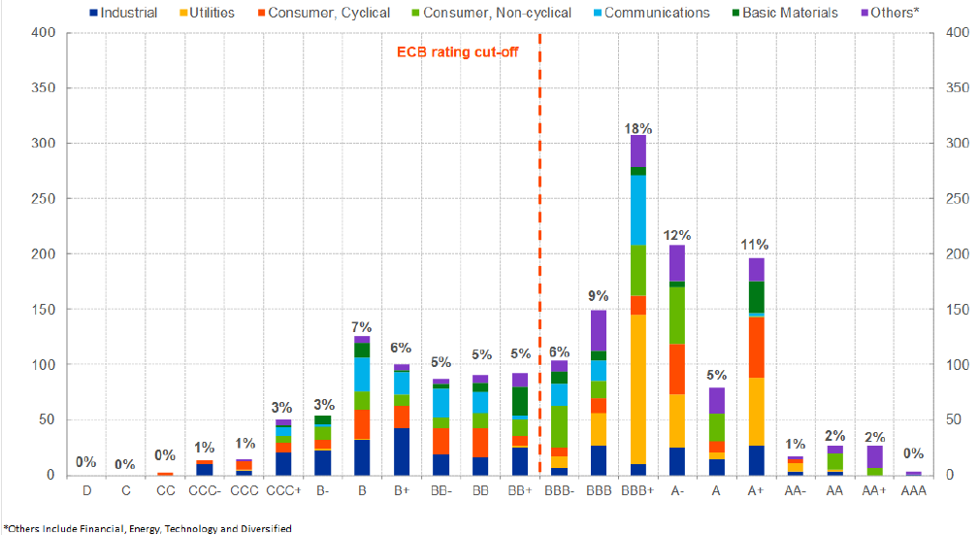
First best ratings by industry
Distribution of corporate bonds with at least a rating
(Distribution per Industry- Percentages, Number – May 2016.)
Sources: Bloomberg , Authors' computation.

Slide 82
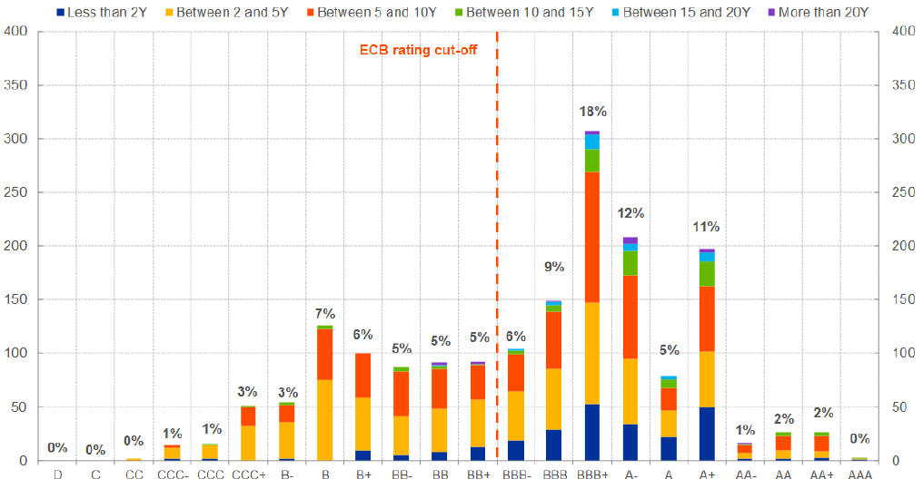
First best ratings by maturity
Distribution of corporate bonds with at least a rating
(Distribution per Maturity - Percentages, Number – May 2016.)
Sources: Bloomberg , Authors' computation.

Slide 83
Firm-level characteristics around the frontier
Profit margin
(percent)
Return on equity (ROE)
(percent)
Sources: Orbis Europe, Bloomberg and other sources.

Slide 84
Firm-level characteristics around the frontier
Net income
(EUR million)
Number of employees
(units)
Sources: Orbis Europe, Bloomberg and other sources.

Slide 85
Firm-level characteristics around the frontier
Total assets
(EUR million)
Operating revenues
(EUR million)
Sources: Orbis Europe, Bloomberg and other sources.

