Slide 1
Investment Challenges and Opportunities in a Low Interest Rate Environment
12th financial risk international forum Institut Louis Bachelier

Slide 2
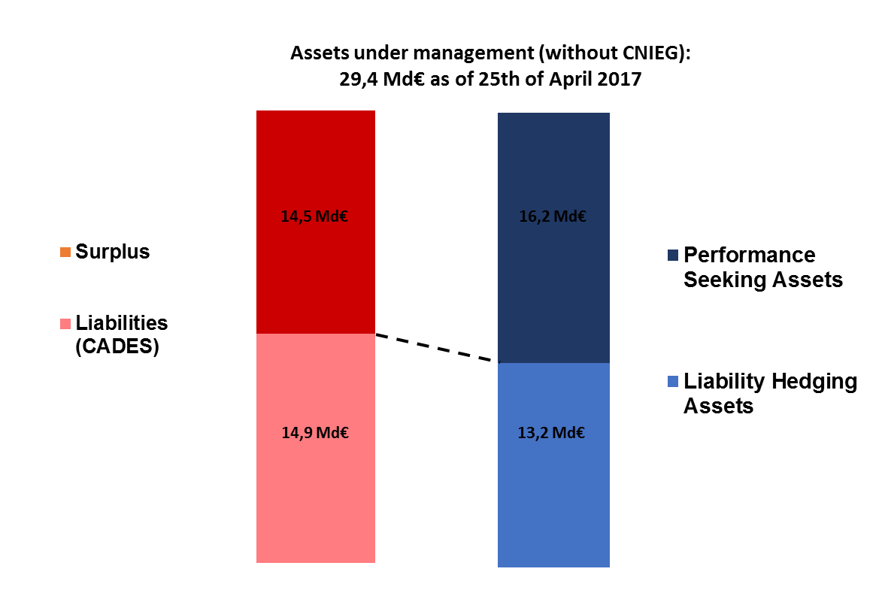
Known liabilities are decreasing and the first horizon is shortening
Investment objectives :
Honor the liability payments
Maximise the remaining surplus in order to create value
LDI implies 2 kinds of assets : hedging assets and performance seeking assets but managing the risk on the surplus now also requires investing in bonds

Slide 3
Meeting the objectives
Hedging the liabilities
Mainly fixed income investments either buy and hold or with rolling maturities
Some performance assets
Maximizing the surplus within risk limits
- Mainly performance assets
- Some fixed income assets
Monte carlo simulations
Stress tests
CVaR 1% in 2024
Median expected value in 2024
Utility function

Slide 4
Impacts ans consequences of low rates
Low and lower expected returns either for the fixed income assets and for the performance assets
Lower protection if none of bond instruments in case of a fall in equities
Asymetry of risk given the economic context (higher losses to be expected if rates or default increase)
High valuation of fixed income assets (négative yield for govies, spread compression in the coporate bond markets …)

Slide 5
Riding the risk curve in the search for a balanced return
Hedging assets
Performance seeking assets
Govies
Corporate bonds
High Yield
Private debt
Option hedged equities

Slide 6
What has done the FRR : searching innovation within traditionnal asset classes
Seek extra performance in equity assets through smart beta techniques
Allow for some high yield in the investment grade mandates (at the manager discretion)
Allow for longer maturity corporate bonds in order to capture higher spread and primary market premium while hedging part of the duration
Hedge equities with options allowing for a higher allocation with limited risks

Slide 7
What has done the FRR : looking for and invest in alternative asset classes
Seek premium and lower volatility in private markets (private debt, private equity, infrastructure, real estate)
Search for new types of investments : cat bonds, hedge funds, risk premia

