Slide 1
Discussion of Portfolio Rho-Presentativity
S.E. Satchell, University of Sydney & Trinity College, Cambridge.
12th Financial Risks International Forum
Paris March 18th

Slide 2
Discussion
Paper presents analysis of portfolios.
Key concepts include representativity and Rho representativity.
Interesting analysis that includes many well-known portfolios including ERC, MV, MDP, EW, EVW, MKT, PCA and Sharpe.

Slide 3
Discussion
A key concept is the diversification ratio.
It is defined for long-only portfolios. It is the ratio of the portfolio weights, multiplied by SD’s divided by the portfolio standard deviation.
It is assumed that the weights add up to one.
It is by no means obvious to me that this is an appropriate measure of diversification in all cases

Slide 4
Discussion
As such it is similar in structure to the Sharpe ratio with SD’s replacing Expected excess returns(all positive)
This analysis would seem to go through for any vector of positive constants suggesting interesting generalisations.
Like the SR it has a maximal value, in the case of Sharpe it is .Under these assumptions adding non-negativity constraints will reduce the max but keep the answer non-negative.

Slide 5
Benefits
Paper presents new unifying results.
This is an original direction of research.
The big extension is to examine DR subject to non-negativity constraints
Result magical, the max DR portfolio has lower correlations within included stocks than with excluded stocks

Slide 6
Criticisms
Mathematics notation not that normally used in Finance, hence limiting readership.
Many ideas could be explained by more well-known financial examples, e.g. top of page 7, where f is an aggregator function. One well known example is the Herfindahl Index.
Commercial applications could be emphasised a little more.In other works they have the max DR portfolio outperforms the market

Slide 7
Criticisms
But, outperformance probably closely related to that of other smart beta strategies.
Suspect very closely correlated to commercial min-vol strategy, rank on stock vol and go long –short or long-only.

Slide 8
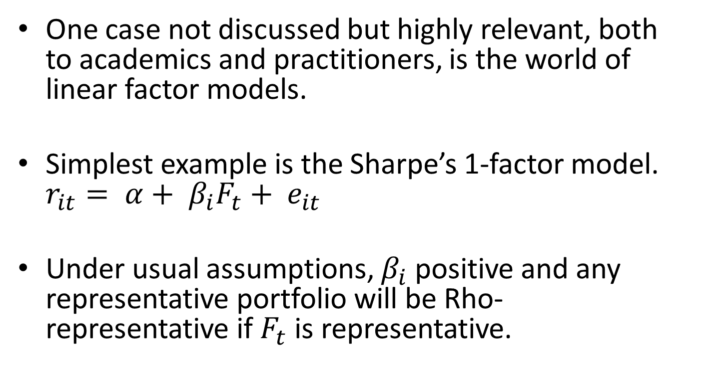
Suggestions
One case not discussed but highly relevant, both to academics and practitioners, is the world of linear factor models.
Simplest example is the Sharpe’s 1-factor model. $r_{it}= α+ β_{i}F_{t}+ e_{it}$
Under usual assumptions, $β_{i}$ positive and any representative portfolio will be Rho-representative if $F_{t}$ is representative.

Slide 9
Further Suggestions
There are probably interesting extensions of relationships in the case of multiple factors.
Look at links with other smart beta strategies
Examine Deworsification, the phenomenon of effectively holding the market in expensive ways; so costs become an important practical issue in terms of multi-manager frameworks.
some information about number of exclusions address this

