Slide 1
Investment Challenges and Opportunities
in a Low Interest Rate Environment
Nathalie Pistre
Head of quantitative research,
support and development

Slide 2
protracted decline in rates
Disinflation and financial intergradation of the world economy
Financial crisis and implementation of unconventional monetary policy.
ECB balance sheet amounts to 40% of euro area GDP
Quantitative Easing retires assets from markets and change long-term market equilibria
Central banks assume considerable duration and credit risks
Low rates may stimulate demand but distort market economies
Asset bubbles
Negative income effect for savers, reduced banking margins
Reduction of borrower screening effects, limiting resource reallocation of labor and capital in the economy

Slide 3
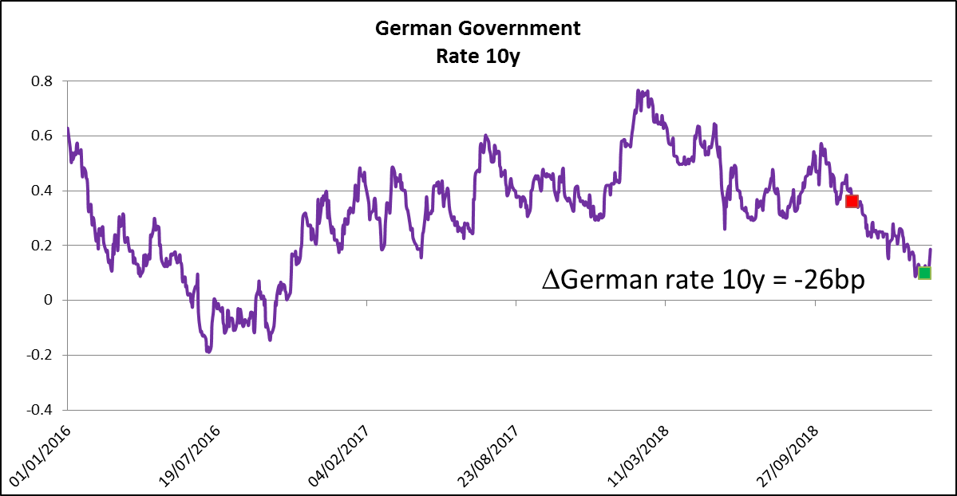
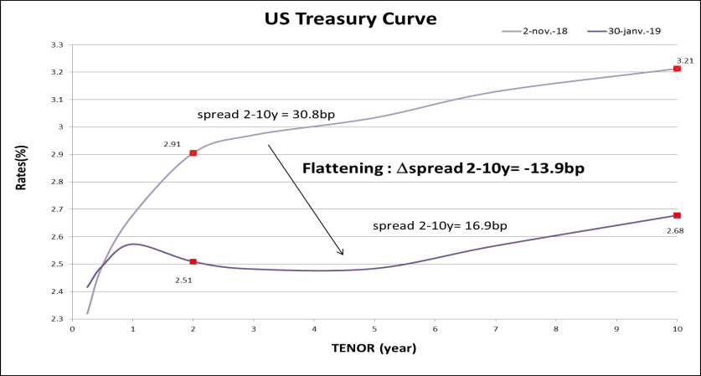
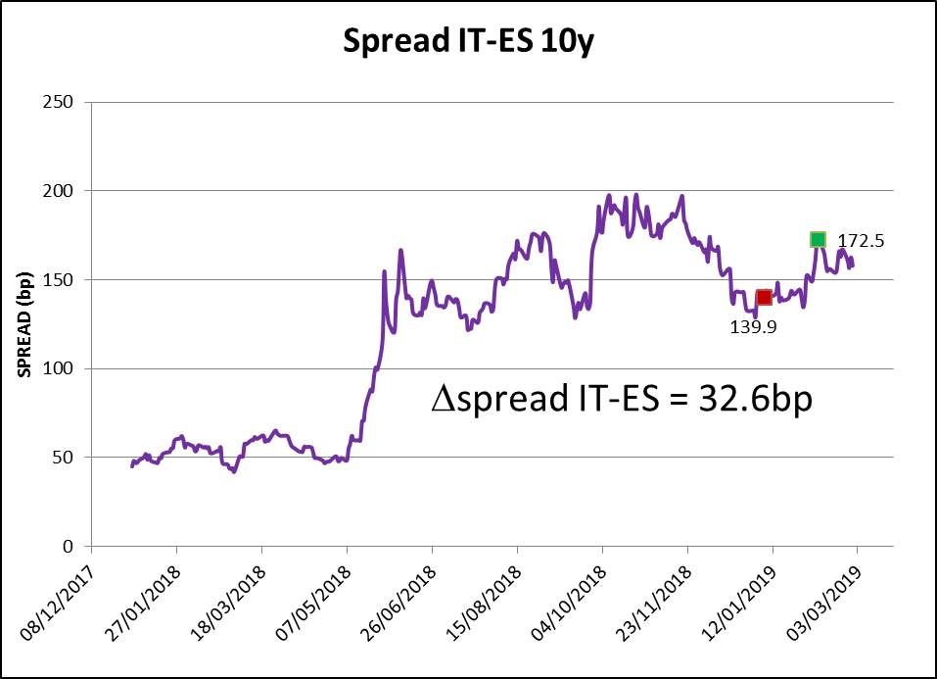
Examples of Active Strategies in low rates environment
2.
Market Directional Bets with Duration strategy (yield curve shift)
Take a long (or short) position on Bund Futures.
Ex: the excess return of a buy strategy from 15 nov.18 to 20 feb.19 is for a exposure of 1 dur. pt equal +26bp (without taking carry into account).
Curve strategY : Bet on the flattening (or steepening) of the curve .
Ex: 2-10y of the US Treasury Curve. The excess return of this strategy from 02/11/18 to 30/01/19 is for a 1 dur. pt exposure equal to 13.9bp.
Relative Value : bet on the widening (or decrease) of a spread
Bet on the widening of the yield spread Italy/Spain. For a 1 point duration exposure, the excess return of the strategy between 07/01/19 to 08/02/19 is equal to $32.6bp$.

Slide 4
value CREATION on Buy & Maintain insurance portfolios
3.
Sources of value creation
What can we measure for portfolio managers?
How?
1
Allocation
Main value creation
(but constrained by ALM and SII)
Characteristics (Book yield, maturity, …) of real investments vs virtual (systematic) investments
2
Timing of Investment
Portfolio managers realized investment vs systematic investment
3
Management of credit downgrade / default alerts
Portfolio managers decisions on credit alerts
Keeping / selling / reinforcing vs
Systematic sale on alert Avoided loss measurement ideally at maturity of the bonds
4
Arbitrage
Yield/duration enhancement with similar ratings and sectors
Delta of yield per Delta of duration (vs swap curve)
5
Diversification
Optimized yield vs. diversification on credit rating and number of issuers / risk reduction
Better credit fundamentals for comparable book yield and duration (Issuer Picking) - Lower Portfolio credit risk due to very high diversification

Slide 5
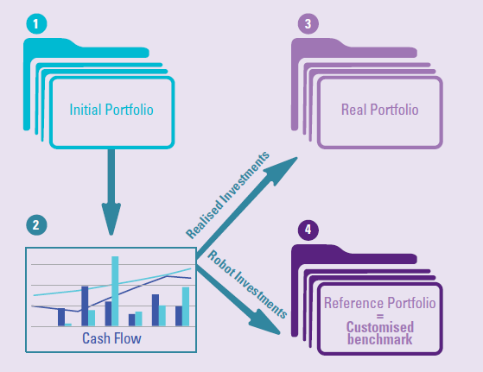
How to Measure performance for insurance portfolios
4.
Future cash flow determined from the Initial Portfolio
Cash Flows are invested
by the Portfolio Manager implementing market views
by the algorithm (determined ex ante) without market anticipation

Slide 6
Diversification on PRIVATE DEBTs
5
 | Definition | Maturity | Spread | Solvency 2
European Corporate Private Placements | Non-rated, unsecured loans to European corporates | 6 -10 years | [1.5-3.5]%
European Leveraged Loans | B-/BB+ rated syndicated loans for LBOs, M&A,… | 7 years (bullet) | EURIBOR + [3-4]%
European Real Estate Debt | Loans to fund European commercial real estate | 5-7 years | Investment grade: yields of [1.5–2.5]% Sub-Investment grade: yields above 3.5% | If the LTV<75%, the SCR is half that of corporate bonds
Aircraft Secured Debt | Secured loans to finance aircraft | 12 years (fully amortising) 5-7 years WAL | LIBOR/mid-swap + [2-2.5]%
Infrastructure Debt | Loans to finance greenfield or brownfield infrastructure projects | 5 years (bullet) to 30 years (fully amortising) | EURIBOR/mid-swap + [2 - 2.5]% | The SCR is around 30% lower than that of corporate bonds
– 6
August 2018

Slide 7
Evolution of Illiquidity premia
5
Source: Infrastructure Journal; Barclays; Ostrum AM; Moodys

Slide 8
Assessing the ilLiquidity Premium
5.
January 2019: Listed Euro corporate bonds rated BBB pays a fixed yield of 1.40%.
A real estate debt fund with assets rated BBB pays a yearly return of 2.25% over a 6-year horizon.
0.85% pickup means being locked
up for 6 years, compared with
a scenario where 1Y yields
increase each year and a 1Y
investment is rolled for six years.
Yields for a 6-year investment and for a “breakeven” 1-year rolling investment with a scenario where this yield increases
→ 0.83% per annum across the investment horizon.

